Slide 1

Alumni Management System
Date: 27th May 2021
M.V.N.S Kavya: 17WH1A05A2
Suhana : 17WH1A0589
G. Tejashwini : 18WH5A0519
Internal Guide: Mr. K. Bhargav Ram
Designation: Assistant Professor
Department of Computer Science & Engineering
BVRIT HYDERABAD College of Engineering for Women

Slide 2
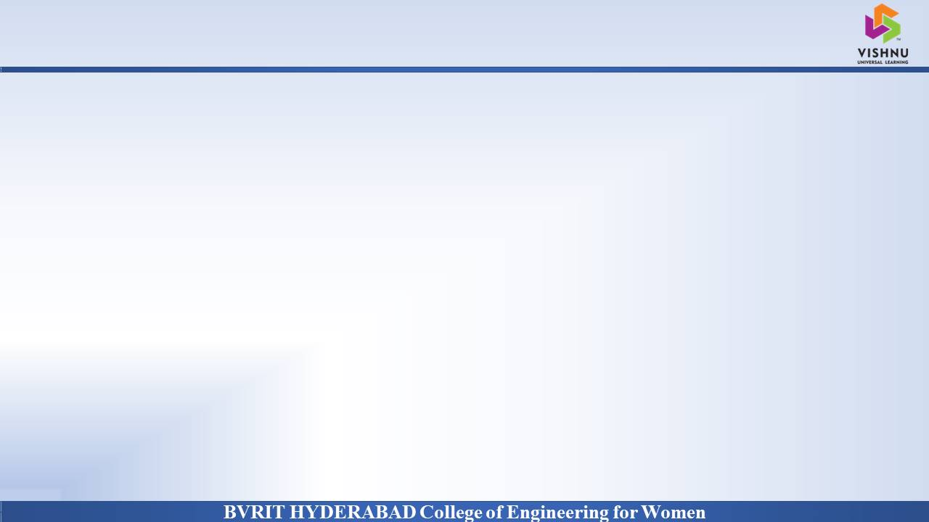
ABSTRACT
Why Should I Study this course?
Alumni Management System is a web application that allows alumni to upload their details, upload materials, post job opportunities, view statistics of college placement achievements.
It also allows students to view job opportunities, view alumni details, view materials uploaded by alumni, it also allows students to participate in group chats with alumni members.
The administrator for this application can verify and authenticate alumni, search for alumni details, generate reports, create events, send messages and emails to alumni members and students to notify them of any events. The admin creates the group chats.
Examples
BVRIT HYDERABAD College of Engineering for Women

Slide 3
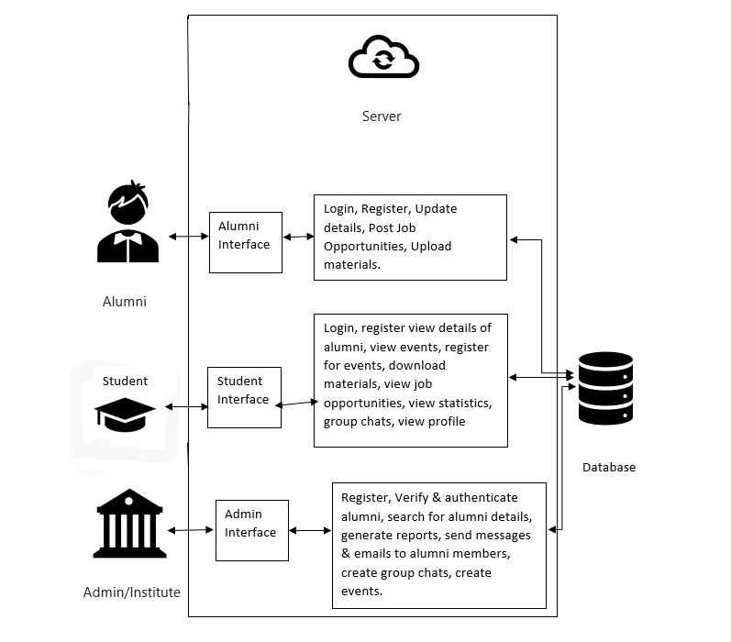
ARCHITECTURE

Slide 4
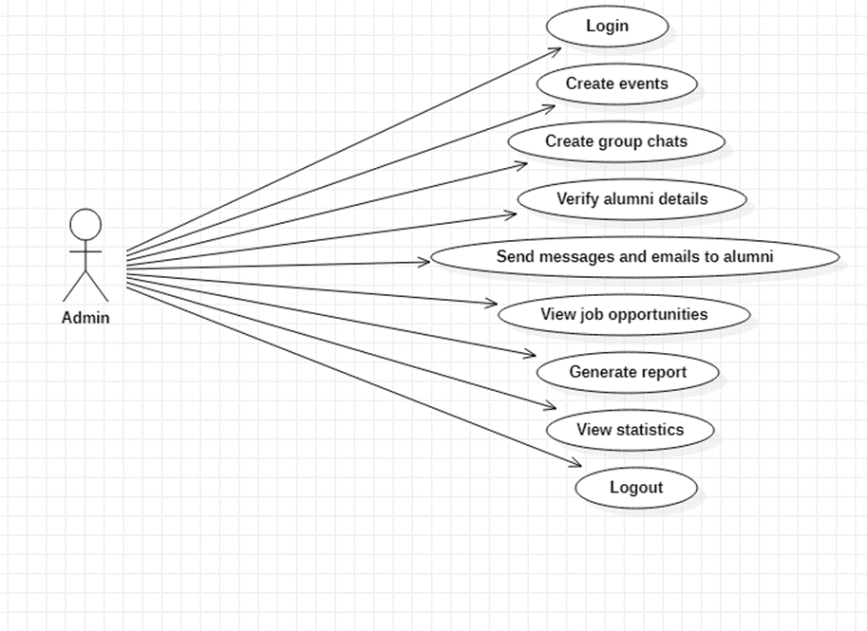
Use case diagram of Admin

Slide 5
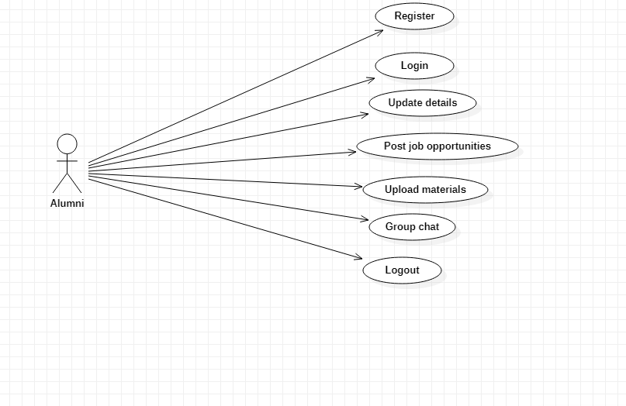
Use case diagram of Alumni

Slide 6
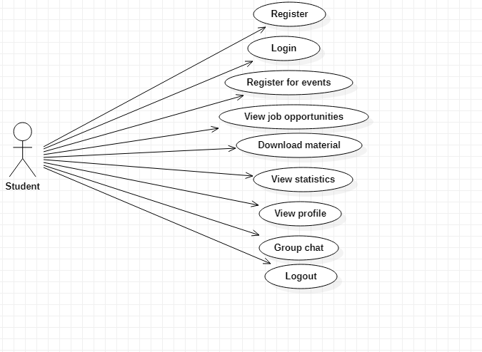
Use case diagram of Student

Slide 7
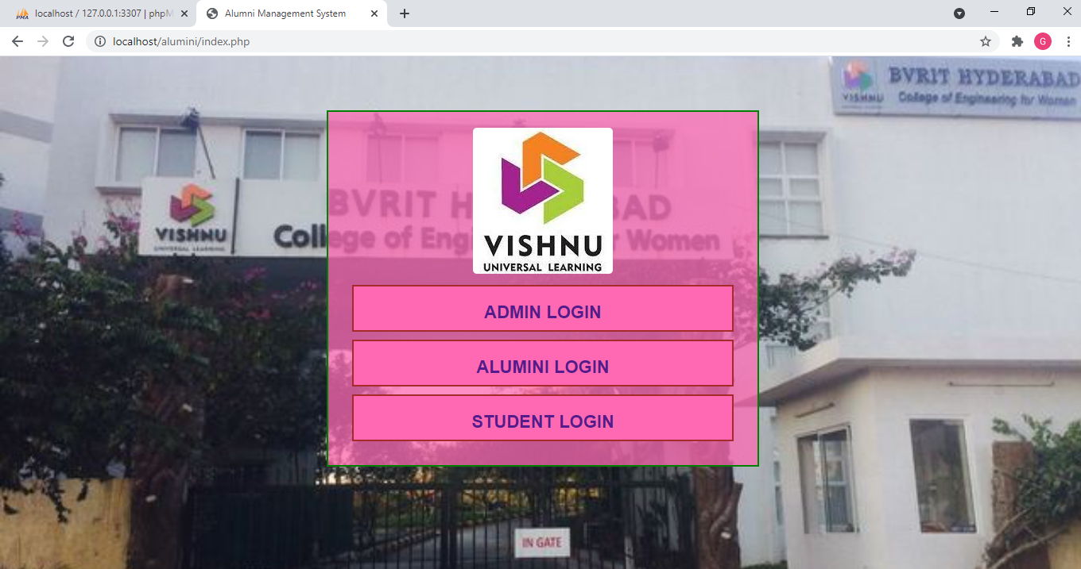
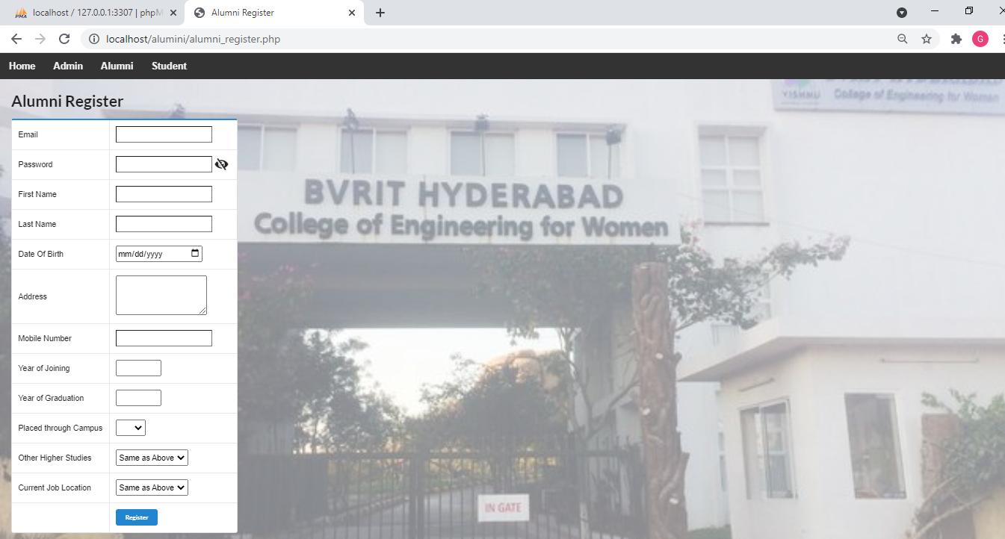
Output

Slide 8
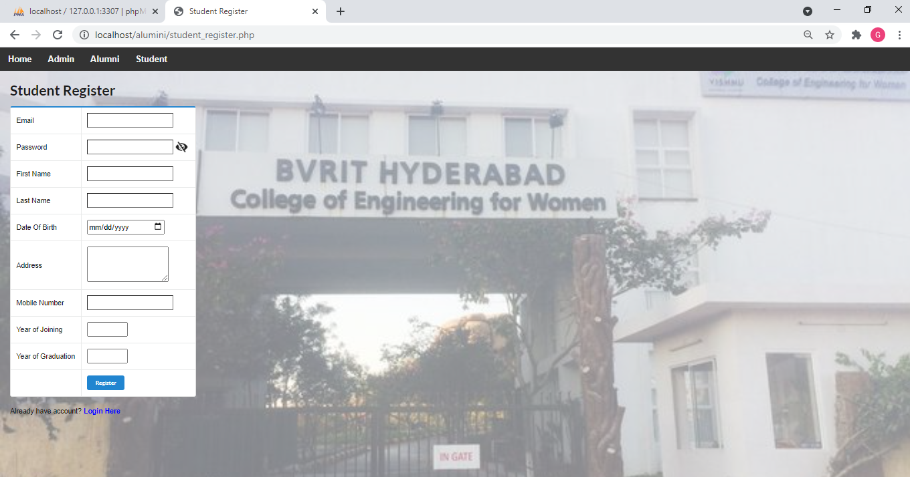
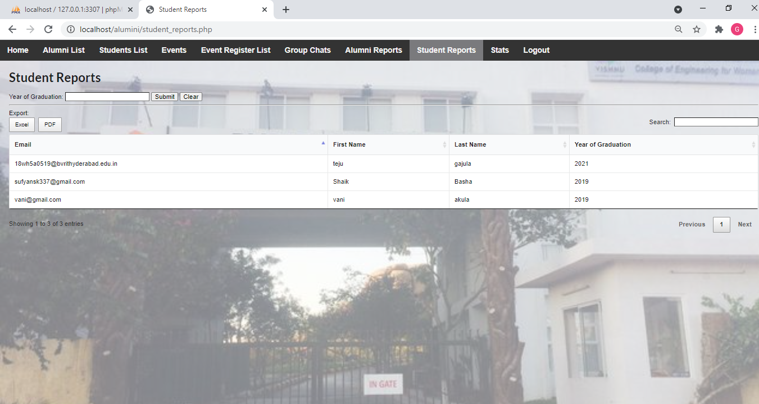

Slide 9

Tools and Technologies
Environment | Specification
Hardware | Processor - Intel Core i3 OS: Windows 8 and above Memory(RAM) - 4 GB Storage – 50 GB or more
Software | XAMPP 1.8.2 MYSQL Server 5.4 Star UML Browser: Microsoft Edge, Google Chrome, Mozilla Firefox
BVRIT HYDERABAD College of Engineering for Women

Slide 10
Thankyou
BVRIT HYDERABAD College of Engineering for Women

